Slide 1
Artificial Intelligence
18BTCS504
Prof. Suresh Kapare

Slide 2
Environment types
Task environments, which are essentially the "problems" to which rational agents are the "solutions.“
Rational Agents: Sensible agents which are taking expected action on percepts
Had to specify the performance measure, the environment, and the agent's actuators and sensors, in group called task environment.
Also called PEAS (Performance, Environment, Actuators, Sensors) description.

Slide 3
Performance measures
A performance measure embodies the criterion for success of an agent's behavior.
An agent in an environment generates a sequence of actions according to the percepts it receives.
This sequence of actions causes the environment to go through a sequence of states.
If the sequence is desirable, then the agent has performed well.
Obviously, there is not one fixed measure suitable for all agents.
As a general rule, it is better to design performance measures according to what one actually wants in the environment, rather than according to how one thinks the agent should behave.

Slide 4
PEAS description for the taxi's task environment.
Performance measure Desirable qualities include getting to the correct destination; minimizing fuel consumption and wear and tear; minimizing the trip time and/or cost; minimizing violations of traffic laws and disturbances to other drivers; maximizing safety and passenger comfort; maximizing profits.
Driving environment variety of roads, ranging from rural lanes and urban alleys to 12-lane freeways. The roads contain other traffic, pedestrians, stray animals, road works, police cars, puddles, and potholes. Interact with potential and actual passengers. Geographical environment.

Slide 5
The actuators control over the engine through the accelerator and control over steering and braking. Display screen or voice synthesizer to talk back to the passengers, and perhaps some way to communicate with other vehicles, politely or otherwise.
Its basic sensors should therefore include one or more controllable TV cameras, the speedometer, and the odometer. an accelerometer; the usual array of engine and electrical system sensors. a satellite global positioning system (GPS), infrared or sonar sensors to detect distances to other cars and obstacles. Finally, it will need a keyboard or microphone for the passenger to request a destination.

Slide 6
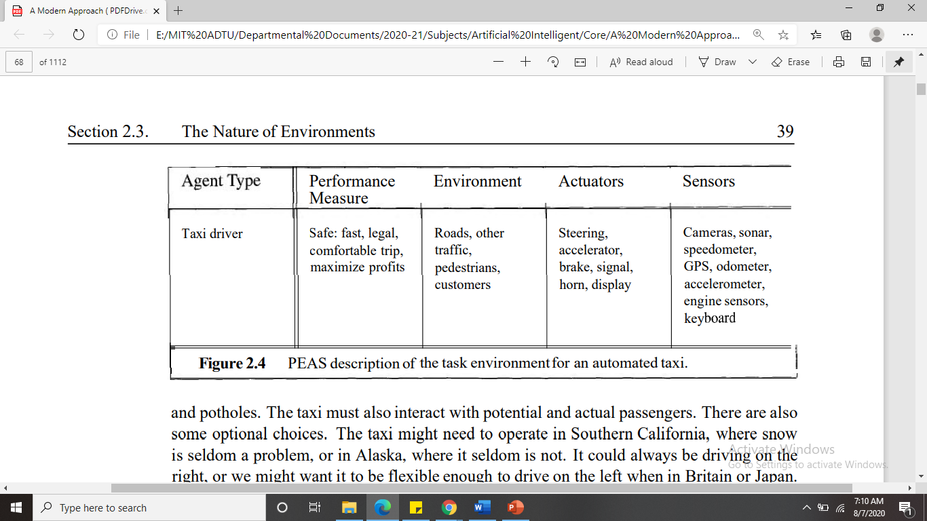

Slide 7
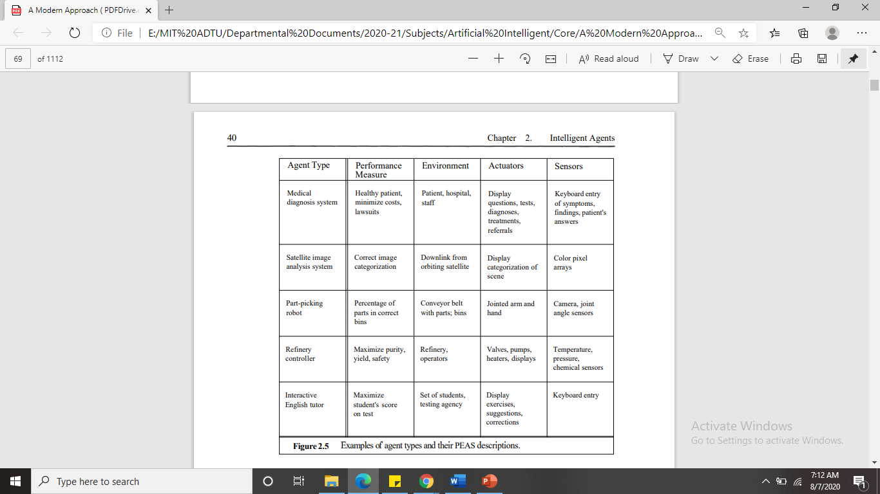

Slide 8
Properties of task environment
Fully observable vs. partially observable If an agent's sensors give it access to the complete state of the environment at each point in time, then we say that the task environment is fully observable.
if the sensors detect all aspects that are relevant to the choice of action;
relevance, in turn, depends on the performance measure.
Fully observable environments are convenient because the agent need not maintain any internal state to keep track of the world.
An environment might be partially observable because of noisy and inaccurate sensors or because parts of the state are simply missing from the sensor data-for example, a vacuum agent with only a local dirt sensor cannot tell whether there is dirt in other squares, and an automated taxi cannot see what other drivers are thinking.

Slide 9
Deterministic vs. stochastic. If the next state of the environment is completely determined by the current state and the action executed by the agent, then we say the environment is deterministic; otherwise, it is stochastic.
In principle, an agent need not worry about uncertainty in a fully observable, deterministic environment. If the environment is partially observable, however, then it could appear to be stochastic.
This is particularly true if the environment is complex, making it hard to keep track of all the unobserved aspects.
Thus, it is often better to think of an environment as deterministic or stochastic from the point of view of the agent.
Taxi driving is clearly stochastic in this sense, because one can never predict the behavior of traffic exactly; moreover, one's tires blow out and one's engine seizes up without warning.
The vacuum world as we described it is deterministic, but variations can include stochastic elements such as randomly appearing dirt and an unreliable suction mechanism. If the environment is deterministic except for the STRATEGIC actions of other agents, we say that the environment is strategic.

Slide 10
Episodic vs. sequential In an episodic task, the agent's experience is divided into atomic episodes. Each episode consists of the agent perceiving and then performing a single action.
Crucially, the next episode does not depend on the actions taken in previous episodes.
In episodic environments, the choice of action in each episode depends only on the episode itself. For example, an agent that has to spot defective parts on an assembly line bases each decision on the current part, regardless of previous decisions; moreover, the current decision doesn't affect whether the next part is defective.
In sequential environments, current decision could affect all future decisions.
Chess and taxi driving are sequential: in both cases, short-term actions can have long-term consequences. Episodic environments are much simpler than sequential environments because the agent does not need to think ahead.

Slide 11
Static vs, dynamic. If the environment can change while an agent is deliberating, then we say the environment is dynamic for that agent; otherwise, it is static.
Static environments are easy to deal with because the agent need not keep looking at the world while it is deciding on an action, nor need it worry about the passage of time.
Dynamic environments, are continuously asking the agent what it wants to do; if it hasn't decided yet, that counts as deciding to do nothing. If the environment itself does not change with the passage of time but the agent's performance score does, then we say the environment is semidynamic.
Taxi driving is clearly dynamic: the other cars and the taxi itself keep moving while the driving algorithm dithers about what to do next. Chess, when played with a clock, is semidynamic. Crossword puzzles are static.

Slide 12
Discrete vs. continuous. The discrete/continuous distinction can be applied to the state of the environment, to the way time is handled, and to the percepts and actions of the agent.
For example, a discrete-state environment such as a chess game has a finite number of distinct states. Chess also has a discrete set of percepts and actions.
Taxi driving is a continuous state and continuous-time problem: the speed and location of the taxi and of the other vehicles sweep through a range of continuous values and do so smoothly over time. Taxi-driving actions are also continuous (steering angles, etc.). Input from digital cameras is discrete, strictly speaking, but is typically treated as representing continuously varying intensities and locations.

Slide 13
Single agent vs. multiagent. The distinction between single-agent and multiagent environments may seem simple enough.
For example, an agent solving a crossword puzzle by itself is clearly in a single-agent environment, whereas an agent playing chess is in a two-agent environment.
There are, however, some subtle issues. First, we have described how an entity may be viewed as an agent, but we have not explained which entities must be viewed as agents.
Does an agent A (the taxi driver for example) have to treat an object B (another vehicle) as an agent, or can it be treated merely as a stochastically behaving object, analogous to waves at the beach or leaves blowing in the wind? The key distinction is whether B's behavior is best described as maximizing a performance measure whose value depends on agent A's behavior. For example, in chess, the opponent entity B is trying to maximize its performance measure, which, by the rules of chess, minimizes agent A's performance measure. Thus, chess is a competitive multiagent environment. In the taxi-driving environment, on the other hand, avoiding collisions maximizes the performance measure of all agents, so it is a partially cooperative multiagent environment. It is also partially competitive because, for example, only one car can occupy a parking space. The agent-design problems arising in multiagent environments are often quite different from those in single-agent environments; for example, communication often emerges as a rational behavior in multiagent environments; in some partially observable competitive environments, stochastic behavior is rational because it avoids the pitfalls of predictability.

Slide 14
